Slide 1
A Perspective Camera Calibration Method
(using correspondences of points between world and digital image coordinates)
Josef Bigun
Halmstad University, Sweden
Based on ch. 13 of J. Bigun: Vision with Direction, Springer, 2006

Slide 2




A Perspective Camera Calibration method
(using correspondences of points between world and digital image coordinates)
$$e_{Y}$$
P´ P
$$e_{Y}$$
y Y
f
$$e_{Z}$$
$$e_{Z}$$
O O´ O’’
Lens
Thus:
Where Y, and y are in length dimension, e.g. meter, millimeter, etc

Slide 3
Perspective Camera Model
If P is not in the vertical plane, but anywhere in front of the box, the mapping problem is still the same.
We can project then P to vertical and horizontal planes and get two planes producing 2 equations: one for horizontal plane, and for vertical plane.
…as illustrated next.

Slide 4

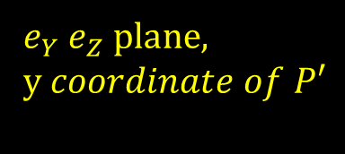
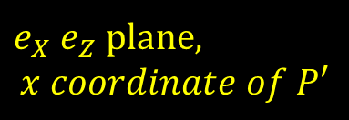


Perspective Camera Model
Assuming P is in
$e_{Y}$ $e_{Z}$ plane, Z>f
$$e_{Y}$$
P´ P
y Y
f
$$e_{Z}$$
O O´ O’’
Assuming P is in anywhere
In camera view i.e. Z>f
$e_{X}$ $e_{Z}$ plane,
$$x coordinate of P′$$
$e_{Y}$ $e_{Z}$ plane,
y$coordinate of P′$
These equations project thus P having X, Y, Z coordinates to P’ having x,y coordinates. Everything, including f, are then in length units, such as meter, i.e. analogue coordinates..

Slide 5
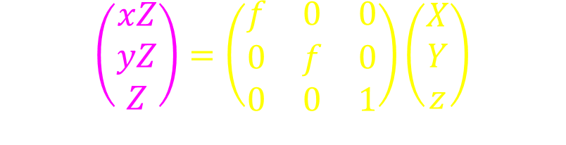
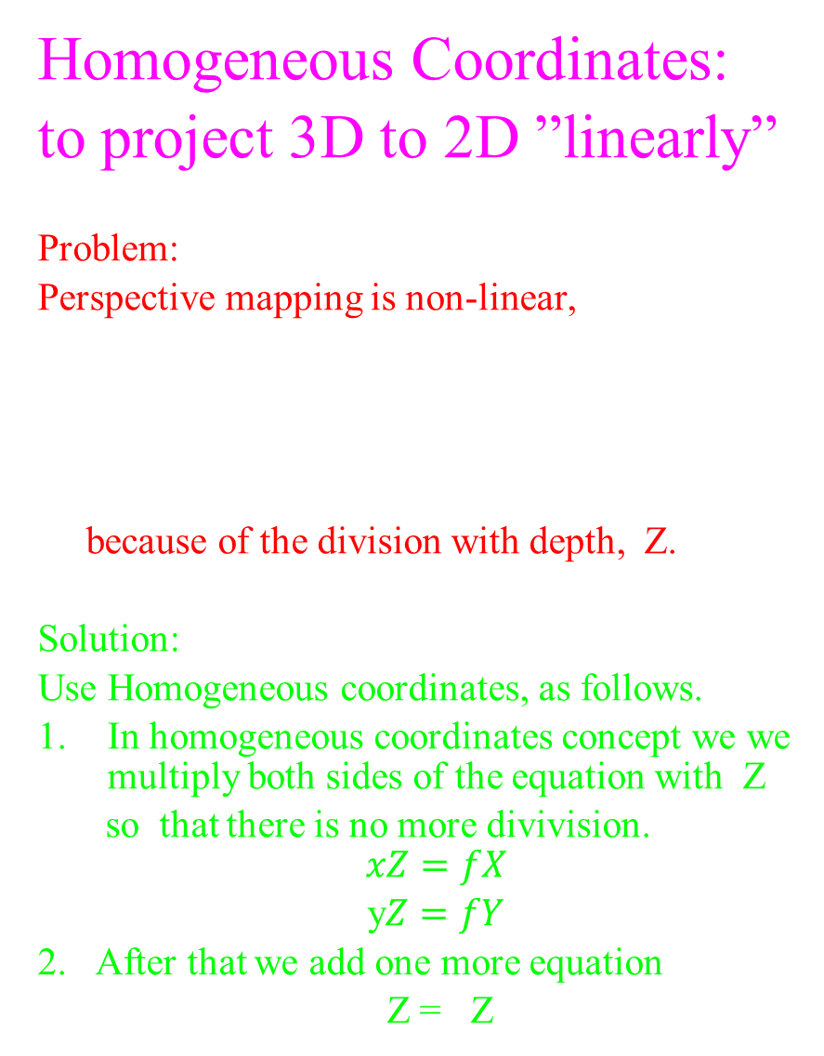
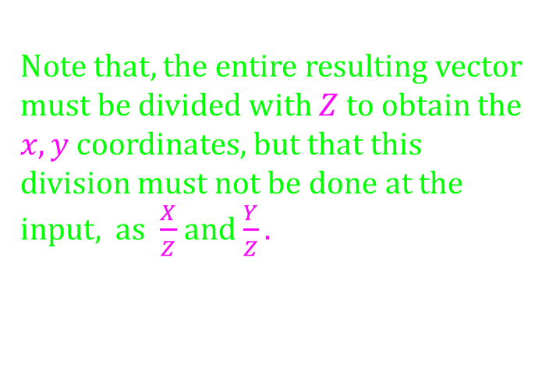
Homogeneous Coordinates:
to project 3D to 2D ”linearly”
Problem:
Perspective mapping is non-linear,
because of the division with depth, Z.
Solution:
Use Homogeneous coordinates, as follows.
In homogeneous coordinates concept we we multiply both sides of the equation with Z
so that there is no more divivision.
$$xZ=fX$$
y$Z=fY$
2. After that we add one more equation
Z = Z
This yields the linear mapping
between the two vectors
$$\left(\begin{aligned}xZ \\ yZ \\ Z\end{aligned}\right)=\left(\begin{matrix}f & 0 & 0 \\ 0 & f & 0 \\ 0 & 0 & 1\end{matrix}\right)\left(\begin{aligned}X \\ Y \\ z\end{aligned}\right)$$
Note that, the entire resulting vector must be divided with $Z$ to obtain the $x,y$ coordinates, but that this division must not be done at the input, as $\frac{X}{Z}$ and $\frac{Y}{Z}.$

Slide 6
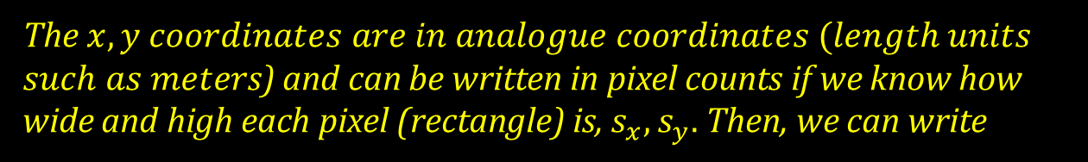


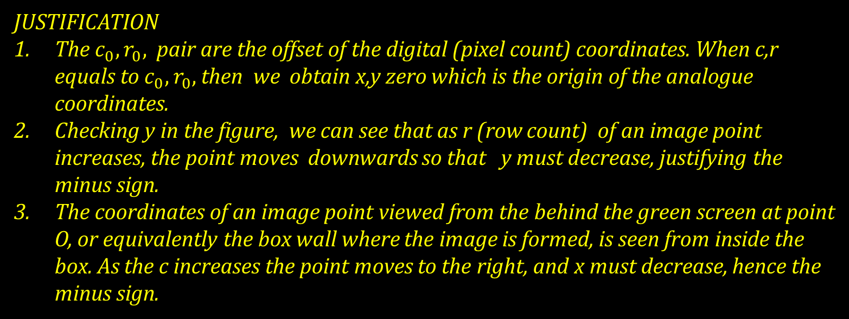
Mapping analogue to digital coordinates
The $x,y$ $coordinates are in analogue coordinates (length units$
$such as meter$s) and can be written in pixel counts if we know how wide and high each pixel (rectangle) is, $s_{x}, s_{y}.$ Then, we can write
$$s_{x}$$
$s_{y}$ size of a pixel
JUSTIFICATION
The $c_{0}, r_{0},$ pair are the offset of the digital (pixel count) coordinates. When c,r equals to $c_{0}, r_{0},$ then we obtain x,y zero which is the origin of the analogue coordinates.
Checking y in the figure, we can see that as r (row count) of an image point increases, the point moves downwards so that y must decrease, justifying the minus sign.
The coordinates of an image point viewed from the behind the green screen at point O, or equivalently the box wall where the image is formed, is seen from inside the box. As the c increases the point moves to the right, and x must decrease, hence the minus sign.

Slide 7
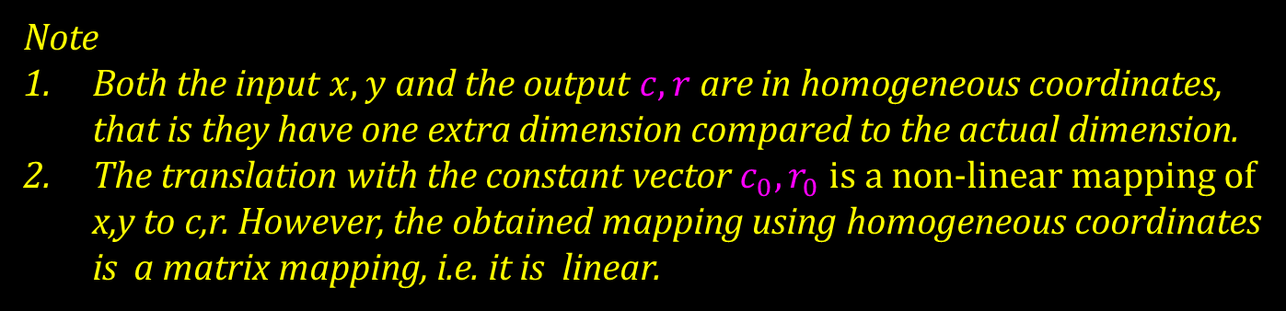
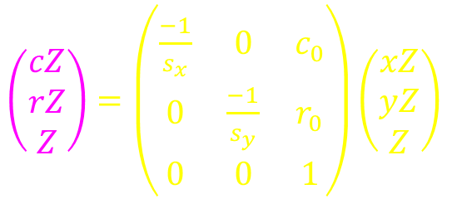
Rewriting (13.11) we obtain 2 actual equations which we multiply with Z and
augment with a non-informative one (at the bottom, Z=Z) to form homogeneous coordinates .
Writing the latter in matrix form we obtain
$\left(\begin{aligned}cZ \\ rZ \\ Z\end{aligned}\right)=\left(\begin{matrix}\frac{−1}{s_{x}} & 0 & c_{0} \\ 0 & \frac{−1}{s_{y}} & r_{0} \\ 0 & 0 & 1\end{matrix}\right)\left(\begin{aligned}xZ \\ yZ \\ Z\end{aligned}\right)$
Note
Both the input $x,y$ and the output $c,r$ are in homogeneous coordinates, that is they have one extra dimension compared to the actual dimension.
The translation with the constant vector $c_{0}, r_{0}$ is a non-linear mapping of x,y to c,r. However, the obtained mapping using homogeneous coordinates is a matrix mapping, i.e. it is linear.

Slide 8
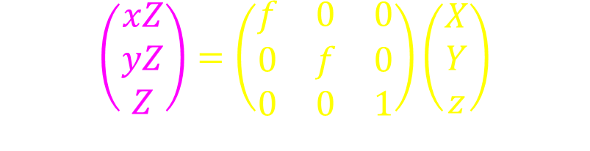

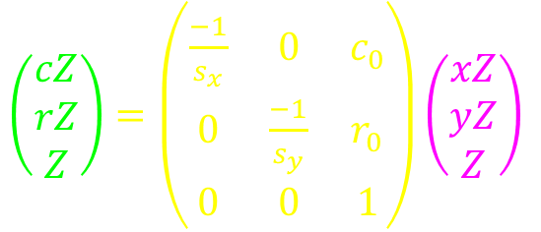
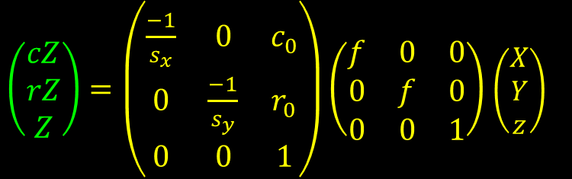
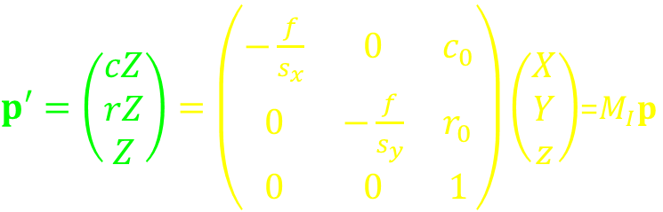
Plugging into
$\left(\begin{aligned}cZ \\ rZ \\ Z\end{aligned}\right)=\left(\begin{matrix}\frac{−1}{s_{x}} & 0 & c_{0} \\ 0 & \frac{−1}{s_{y}} & r_{0} \\ 0 & 0 & 1\end{matrix}\right)\left(\begin{aligned}xZ \\ yZ \\ Z\end{aligned}\right)$
the perspective mapping
$$\left(\begin{aligned}xZ \\ yZ \\ Z\end{aligned}\right)=\left(\begin{matrix}f & 0 & 0 \\ 0 & f & 0 \\ 0 & 0 & 1\end{matrix}\right)\left(\begin{aligned}X \\ Y \\ z\end{aligned}\right)$$
$\left(\begin{aligned}cZ \\ rZ \\ Z\end{aligned}\right)=\left(\begin{matrix}\frac{−1}{s_{x}} & 0 & c_{0} \\ 0 & \frac{−1}{s_{y}} & r_{0} \\ 0 & 0 & 1\end{matrix}\right)\left(\begin{matrix}f & 0 & 0 \\ 0 & f & 0 \\ 0 & 0 & 1\end{matrix}\right)$ $\left(\begin{aligned}X \\ Y \\ z\end{aligned}\right)$
$$⇒$$
yields the linear mapping
$p′=\left(\begin{aligned}cZ \\ rZ \\ Z\end{aligned}\right)=\left(\begin{matrix}−\frac{f}{s_{x}} & 0 & c_{0} \\ 0 & −\frac{f}{s_{y}} & r_{0} \\ 0 & 0 & 1\end{matrix}\right)\left(\begin{aligned}X \\ Y \\ z\end{aligned}\right)$=$M_{I}p$
where the input $p$ is in camera coordinates, the output $p′$is in homogeneous digital image coordinates. The mapping is linear and achieved by the intrinsic matrix, $M_{I}.$

Slide 9
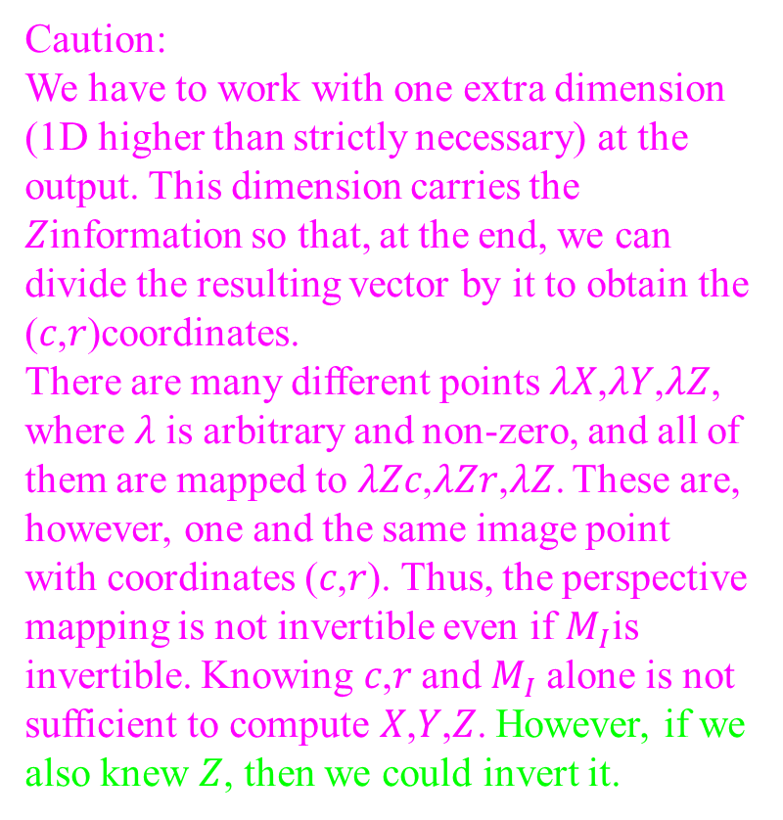
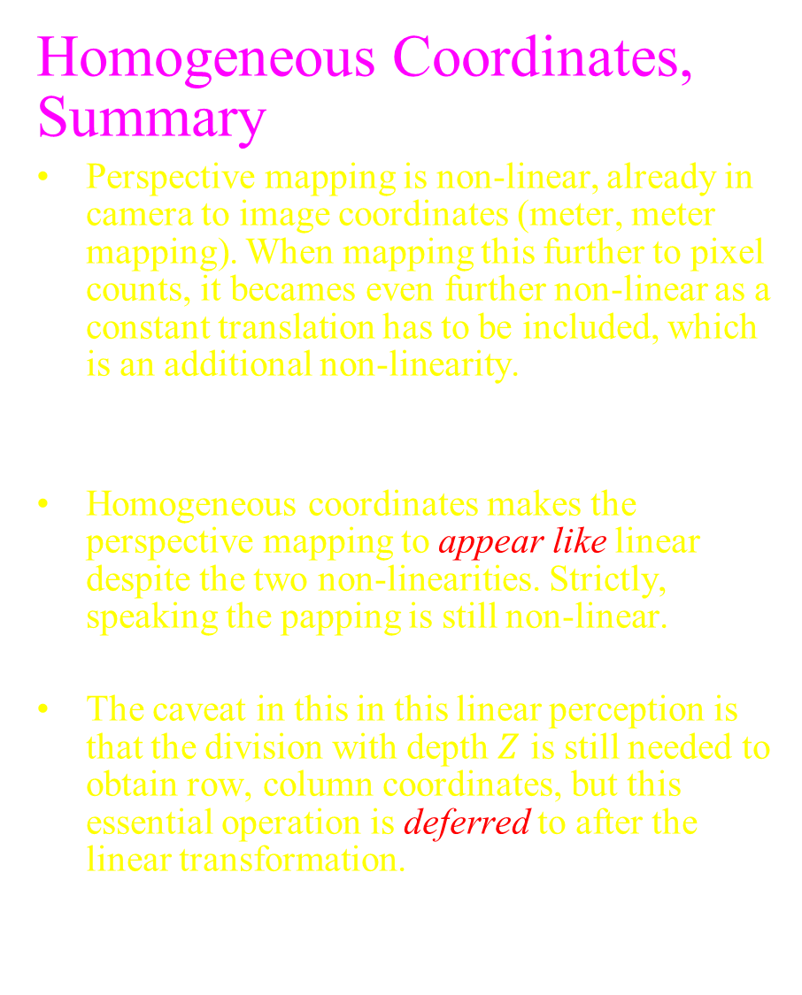
Homogeneous Coordinates, Summary
Perspective mapping is non-linear, already in camera to image coordinates (meter, meter mapping). When mapping this further to pixel counts, it becames even further non-linear as a constant translation has to be included, which is an additional non-linearity.
Homogeneous coordinates makes the perspective mapping to appear like linear despite the two non-linearities. Strictly, speaking the papping is still non-linear.
The caveat in this in this linear perception is that the division with depth $Z$ is still needed to obtain row, column coordinates, but this essential operation is deferred to after the linear transformation.
Caution:
We have to work with one extra dimension (1D higher than strictly necessary) at the output. This dimension carries the 𝑍information so that, at the end, we can divide the resulting vector by it to obtain the (𝑐,𝑟)coordinates.
There are many different points 𝜆𝑋,𝜆𝑌,𝜆𝑍, where 𝜆 is arbitrary and non‑zero, and all of them are mapped to 𝜆𝑍𝑐,𝜆𝑍𝑟,𝜆𝑍. These are, however, one and the same image point with coordinates (𝑐,𝑟). Thus, the perspective mapping is not invertible even if $M_{I}$is invertible. Knowing 𝑐,𝑟 and $M_{I}$alone is not sufficient to compute 𝑋,𝑌,𝑍. However, if we also knew 𝑍, then we could invert it.

Slide 10
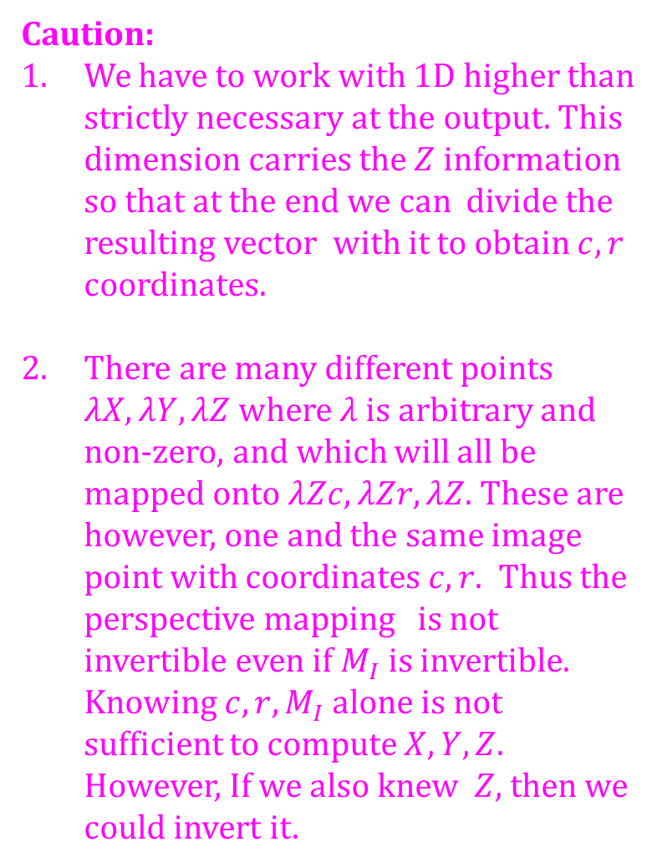
Homogeneous Coordinates, Summary
Perspective mapping is non-linear, already in camera to image coordinates (meter, meter mapping). When mapping this further to pixel counts, it becames even further non-linear as a constant translation has to be included, which is an additional non-linearity.
Homogeneous coordinates makes the perspective mapping to appear like linear despite the two non-linearities. Strictly, speaking the papping is still non-linear.
The caveat in this in this linear perception is that the division with depth $Z$ is still needed to obtain row, column coordinates, but this essential operation is deferred to after the linear transformation.
Caution:
We have to work with 1D higher than strictly necessary at the output. This dimension carries the $Z$ information so that at the end we can divide the resulting vector with it to obtain $c,r$ coordinates.
There are many different points $λX,λY,λZ$ where $λ$ is arbitrary and non-zero, and which will all be mapped onto $λZc,λZr,λZ$. These are however, one and the same image point with coordinates $c,r.$ Thus the perspective mapping is not invertible even if $M_{I}$ is invertible. Knowing $c,r, M_{I}$ alone is not sufficient to compute $X,Y,Z$. However, If we also knew $Z,$ then we could invert it.

Slide 11
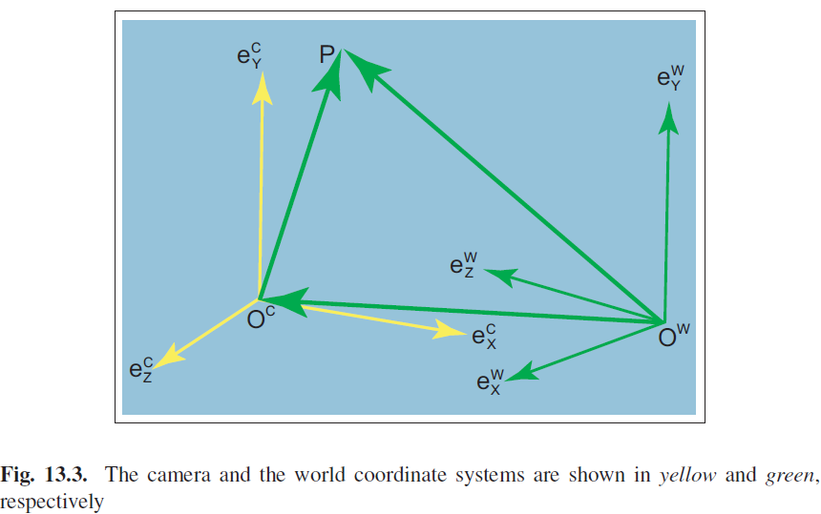

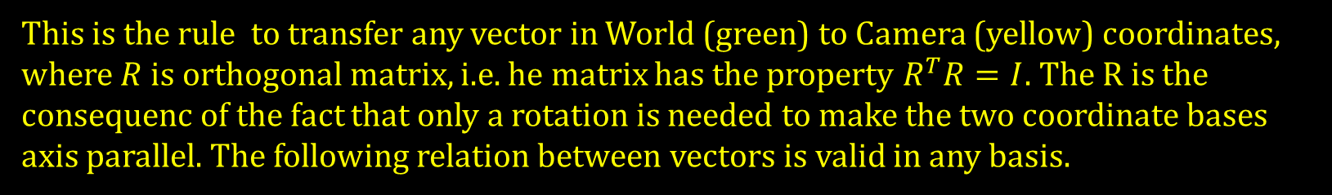
This is the rule to transfer any vector in World (green) to Camera (yellow) coordinates, where $R$ is orthogonal matrix, i.e. he matrix has the property $R^{T}R=I$. The R is the consequenc of the fact that only a rotation is needed to make the two coordinate bases axis parallel. The following relation between vectors is valid in any basis.

Slide 12
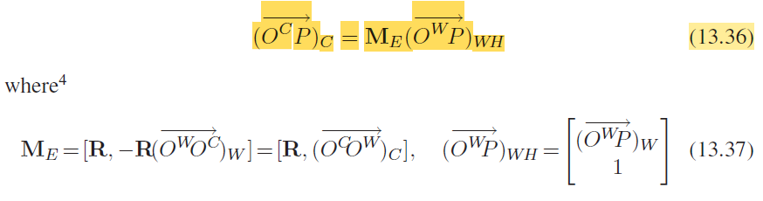
We write the previous equation in the World
basis and modify it by using the transfer rule as
expressing a vector in Camera basis is needed.
Now, padding the world coordinates of the point P with 1, and using homogeneous
coordinates we obtain a pure matrix multiplicaton to go from World Homogeneous
Coordinates to Camera coordinates of the point P, as follows.

Slide 13
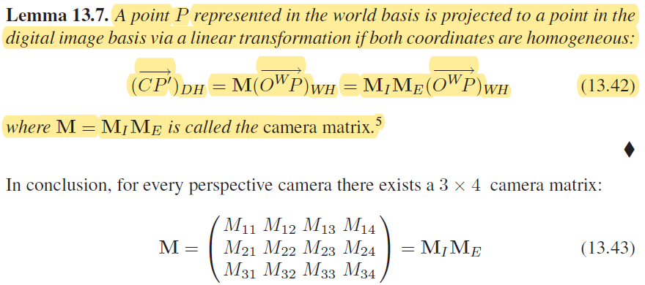
However, once in Camera basis we can simply multiply it with ${ M}_{I}$ to obtain Digital Image Homogeneous coordinates yielding the following lemma.

Slide 14
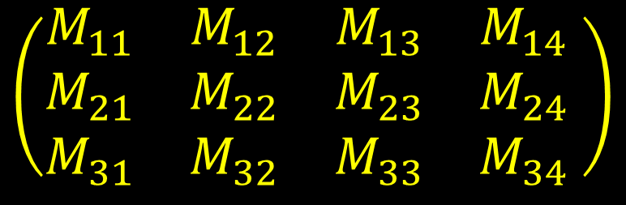
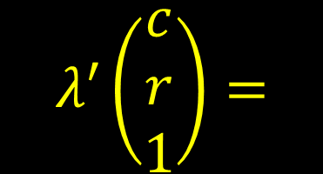
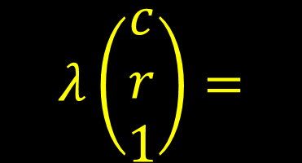
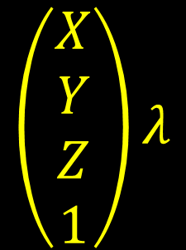
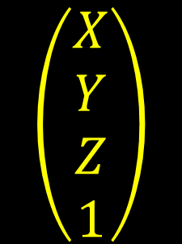
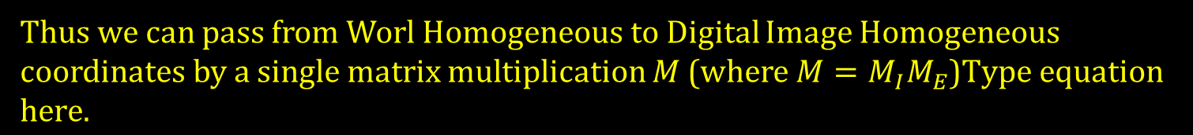

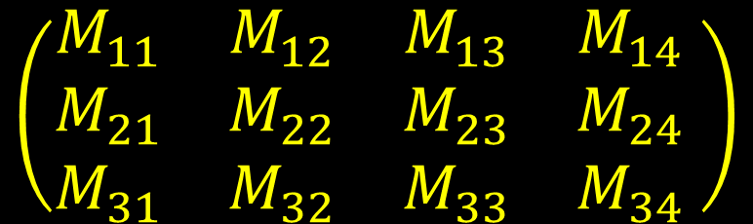

Thus we can pass from Worl Homogeneous to Digital Image Homogeneous coordinates by a single matrix multiplication $M$ (where $M=M_{I}M_{E}$)
$$\left(\begin{matrix}M_{11} & M_{12} & M_{13} & M_{14} \\ M_{21} & M_{22} & M_{23} & M_{24} \\ M_{31} & M_{32} & M_{33} & M_{34}\end{matrix} \right)$$
$$\left(\begin{matrix}X \\ Y \\ Z \\ 1\end{matrix}\right)λ$$
$$λ′\left(\begin{matrix}c \\ r \\ 1\end{matrix}\right)=$$
We can merge $λ^{′}and λ$ to a single $λ$ on the left side by division
$$\left(\begin{matrix}X \\ Y \\ Z \\ 1\end{matrix}\right)$$
$$λ\left(\begin{matrix}c \\ r \\ 1\end{matrix}\right)=$$
$$\left(\begin{matrix}M_{11} & M_{12} & M_{13} & M_{14} \\ M_{21} & M_{22} & M_{23} & M_{24} \\ M_{31} & M_{32} & M_{33} & M_{34}\end{matrix} \right)$$
$$λ p′$$
$$p$$

Slide 15

Thus 1 pair of correspondance,
p $and{ p}^{′}$,
gives:
Eliminating λ by substituting the last equation into the first two gives:
The yellow bubble means that there is a typo in the book (corrected)
This, in turn can be written as two scalar products between
and
as

Slide 16
Then N pairs will produce a set of 2N (known vectors):
Grouping the column and row dependent (12-D)
vectors together by reshuffling yields

Slide 17
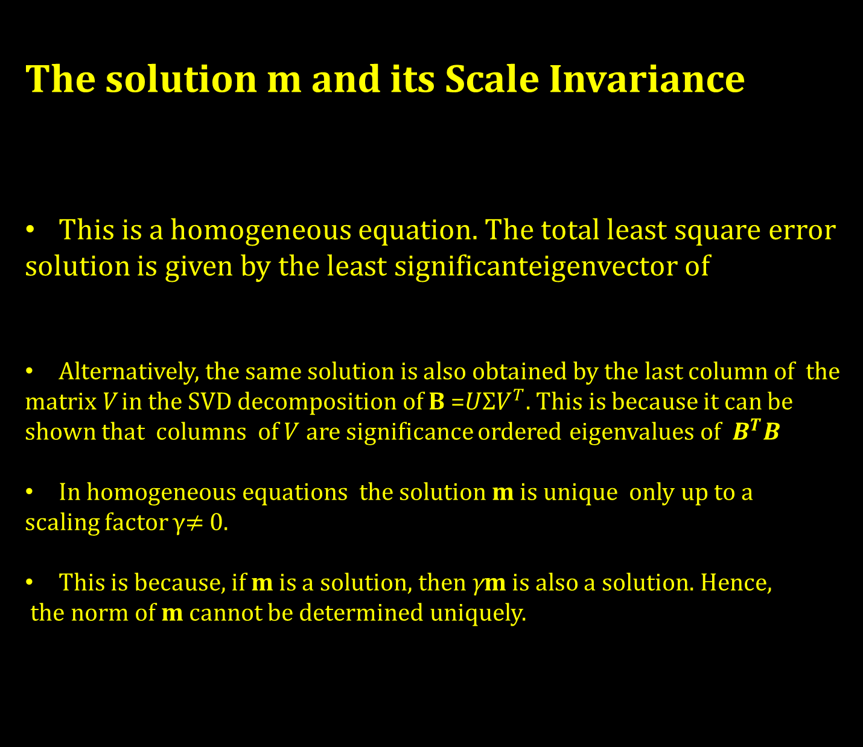
The solution $m$ and its Scale Invariance
This is a homogeneous equation. The total least square error
solution is given by the least significanteigenvector of
Alternatively, the same solution is also obtained by the last column of the
matrix V in the SVD decomposition of B =$UΣV^{T}$. This is because it can be
shown that columns of $V$ are significance ordered eigenvalues of $B^{T}B$
In homogeneous equations the solution m is unique only up to a
scaling factor γ$≠$ 0.
This is because, if m is a solution, then γm is also a solution. Hence,
the norm of m cannot be determined uniquely.

Slide 18
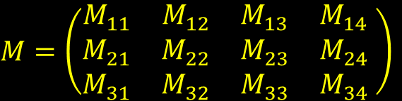

From m to Physics, i.e. Decompose M into $M_{I}M_{E}$
The solution $m$ gives us the matrix M
Which is equal to the product $M_{I}M_{E}$ expanded as
Here, we can identify that $R_{31},R_{32},$ $R_{33}$ should be equal to the known values $M_{31},M_{32},$ $M_{33}$
except for a multiplication by $γ$ which is befitting because the vector ${(R}_{31},R_{32},$ $R_{33}$) should have the norm 1 due to $R$ being an orthoghonal matrix.
$M=\left(\begin{matrix}M_{11} & M_{12} & M_{13} & M_{14} \\ M_{21} & M_{22} & M_{23} & M_{24} \\ M_{31} & M_{32} & M_{33} & M_{34}\end{matrix} \right)$

Slide 19


We arrange this by normalizing the known matrix $M$ with
We then adjust $γ$ with a sign such that $M_{34}$ is positive, to make sure that the world point $p$ is in front of the camera (so that it can be visible to the camera).
$$γ←Sign\left(M_{34}\right)γ$$
Taking the scalar products between the first, second and the last, rows of the expanded $M_{I}M_{E}$ matrix except the last column, and using $R^{T}R=I$ yields.

Slide 20
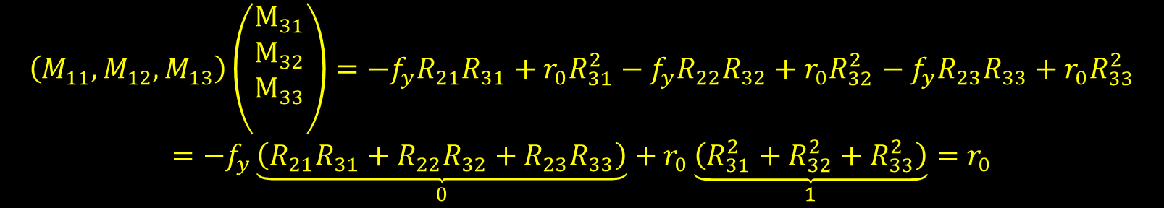
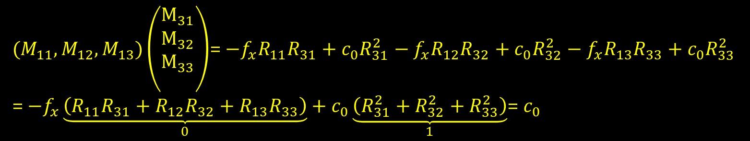
The yellow bubble means that there is a typo in the book (corrected)
$(M_{11},M_{12},M_{13})\left(\begin{matrix}M_{31} \\ M_{32} \\ M_{33} \\ \end{matrix}\right)$= $−f_{x}R_{11}R_{31}+c_{0}R_{31}^{2}−f_{x}R_{12}R_{32}+c_{0}R_{32}^{2}−f_{x}R_{13}R_{33}+c_{0}R_{33}^{2}$
= $−f_{x}\underset{0}{\underbrace{\left(R_{11}R_{31}+R_{12}R_{32}+R_{13}R_{33}\right)}}+c_{0}\underset{1}{\underbrace{\left(R_{31}^{2}+R_{32}^{2}+R_{33}^{2}\right)}}$= $c_{0}$
$$\left(M_{11},M_{12},M_{13}\right)\left(\begin{matrix}M_{31} \\ M_{32} \\ M_{33} \\ \end{matrix}\right)=−f_{y}R_{21}R_{31}+r_{0}R_{31}^{2}−f_{y}R_{22}R_{32}+r_{0}R_{32}^{2}−f_{y}R_{23}R_{33}+r_{0}R_{33}^{2}$$
$$=−f_{y}\underset{0}{\underbrace{\left(R_{21}R_{31}+R_{22}R_{32}+R_{23}R_{33}\right)}}+r_{0}\underset{1}{\underbrace{\left(R_{31}^{2}+R_{32}^{2}+R_{33}^{2}\right)}}=r_{0}$$

Slide 21
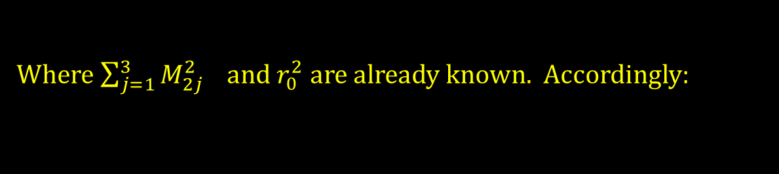
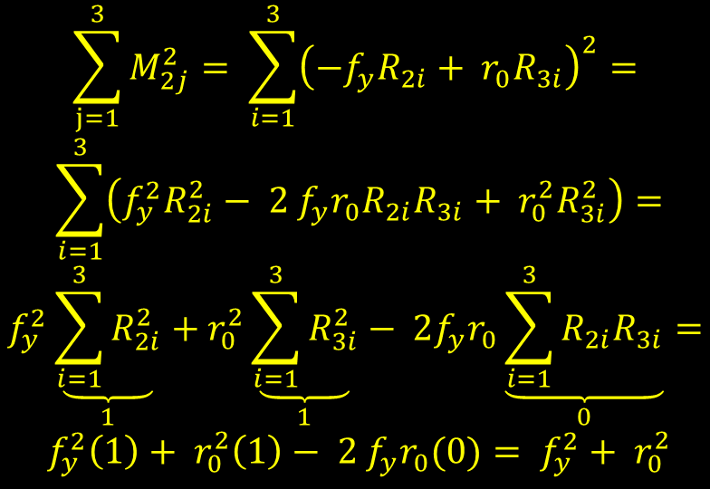
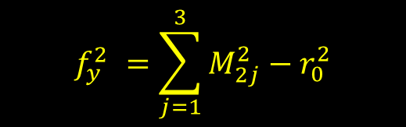
Likewise we show that the norm of the second row of M (except 4th column)
evaluates to
$$\sum_{j=1}^{3}{M_{2j}^{2}}= \sum_{i=1}^{3}{{\left(−f_{y}R_{2i}+ r_{0}R_{3i}\right)}^{2}}=$$
$$\sum_{i=1}^{3}{\left(f_{y}^{2}R_{2i}^{2}− 2 f_{y}r_{0}R_{2i}R_{3i}+ r_{0}^{2}R_{3i}^{2}\right)}=$$
$$f_{y}^{2}\underset{1}{\underbrace{\sum_{i=1}^{3}{R_{2i}^{2}}}}+r_{0}^{2}\underset{1}{\underbrace{\sum_{i=1}^{3}{R_{3i}^{2}}}}− 2f_{y}r_{0}\underset{0}{\underbrace{\sum_{i=1}^{3}{R_{2i}R_{3i}}}}=$$
$$f_{y}^{2}\left(1\right)+ r_{0}^{2}\left(1\right)− 2 f_{y}r_{0}(0)= f_{y}^{2}+ r_{0}^{2}$$
Where $\sum_{j=1}^{3}{M_{2j}^{2}} and r_{0}^{2}$are already known. Accordingly:
$$f_{y}^{2} =\sum_{j=1}^{3}{M_{2j}^{2}}−r_{0}^{2}$$

Slide 22

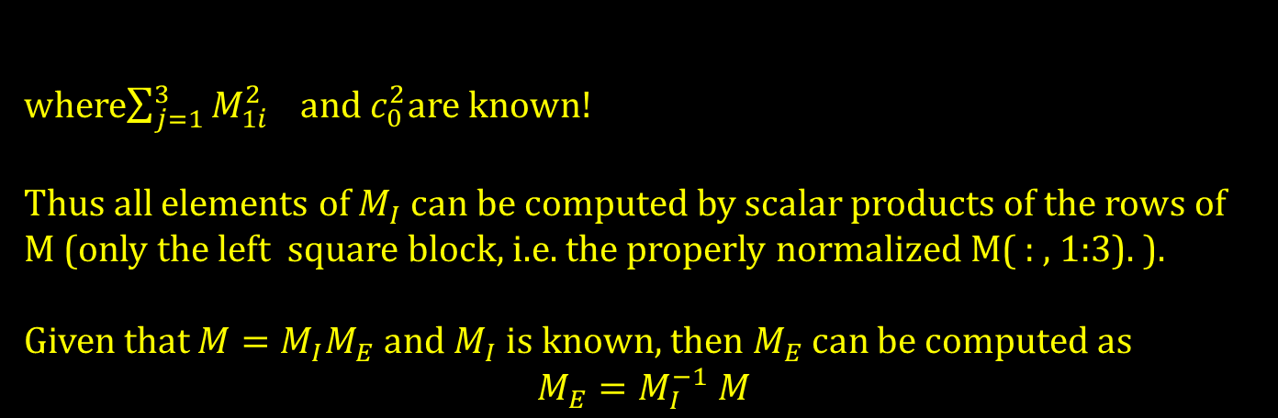
Similarly we can obtain
$$f_{x}^{2} =\sum_{j=1}^{3}{M_{1j}^{2}}−c_{0}^{2}$$
where$\sum_{j=1}^{3}{M_{1i}^{2}} and{ c}_{0}^{2}$are known!
Thus all elements of $M_{I}$ can be computed by scalar products of the rows of M (only the left square block, i.e. the properly normalized M( : , 1:3). ).
Given that $M=M_{I}M_{E}$and $M_{I}$ is known, then $M_{E}$ can be computed as
$$M_{E}=M_{I}^{−1} M$$

Slide 23
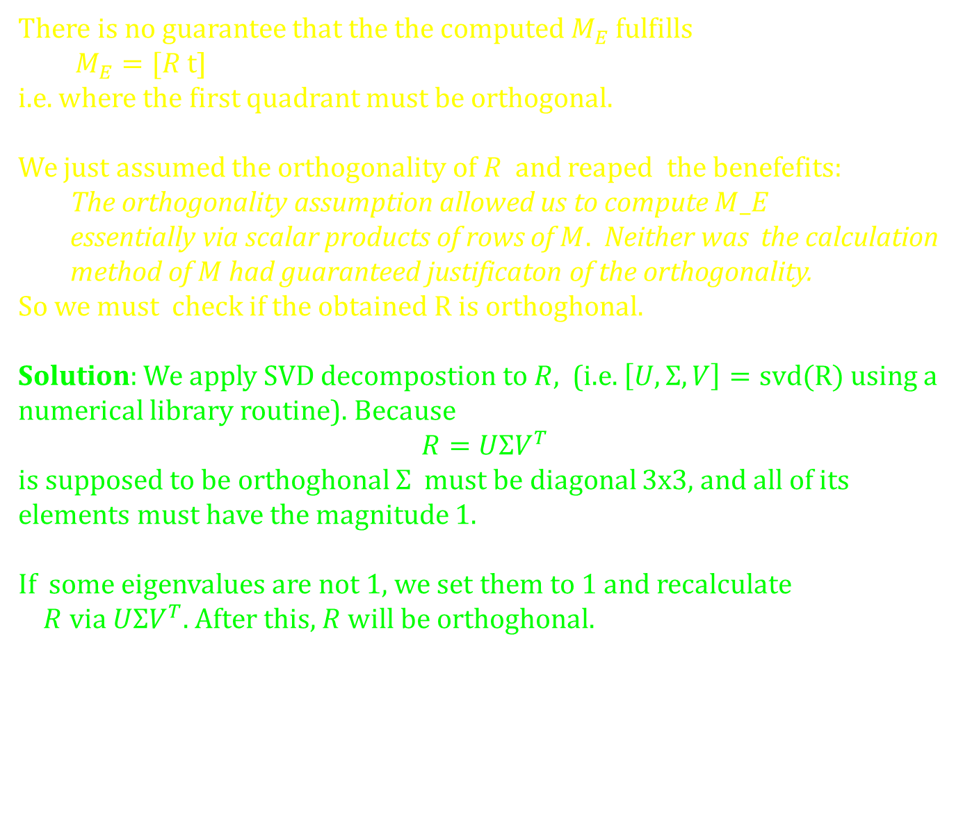
There is no guarantee that the the computed $M_{E}$ fulfills
$M_{E}=[R$ t]
i.e. where the first quadrant must be orthogonal.
We just assumed the orthogonality of $R$and reaped the benefefits:
  The orthogonality assumption allowed us to compute $M_E$
  essentially via scalar products of rows of $M.$ Neither was the calculation
  method of $M$ had guaranteed justificaton of the orthogonality.
So we must check if the obtained $R$ is orthoghonal.
Solution: We apply SVD decompostion to $R$, (i.e. $\left[U,Σ,V\right]=svd(R)$ using a
numerical library routine). Because
$$R=UΣV^{T}$$
is supposed to be orthoghonal $Σ$ must be diagonal 3x3, and all of its
elements must have the magnitude 1.
If some eigenvalues are not 1, we set them to 1 and recalculate
$R$ via $UΣV^{T}$. After this, $R$ will be orthoghonal.

Slide 24
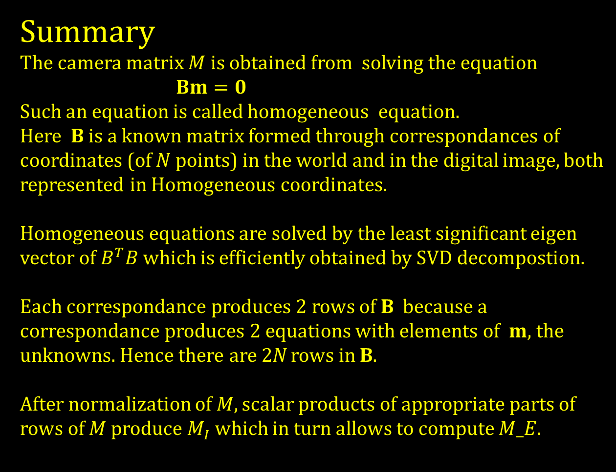
Summary
The camera matrix $M$is obtained from solving the equation
$Bm=0$
Such an equation is called homogeneous equation.
Here B is a known matrix formed through correspondances of coordinates (of $N$ points) in the world and in the digital image, both represented in Homogeneous coordinates.
Homogeneous equations are solved by the least significant eigen vector of $B^{T}B$ which is efficiently obtained by SVD decompostion.
Each correspondance produces 2 rows of B because a correspondance produces 2 equations with elements of $m$, the unknowns. Hence there are 2N rows in B.
After normalization of $M, s$calar products of appropriate parts of rows of $M$ produce $M_{I}$ which in turn allows to compute $M_E$.

