Slide 1
Motion Analysis tools- Optical Flow by correlation/dfd
Josef Bigun
J. Bigun: Vision with Direction, Springer, Heidelberg, 2006.
(Chapter 12. Sections: 12.12, 12.4, 12.6, 12.10
Notes:
The mouth of truth - is a lie detector and it was believed that if one told a lie with one's hand in the mouth of the sculpture, it would be bitten off. Our work is also to develop a lie detector but with no harm to people.

Slide 2
Motion field analysis
Video Compression, e.g. MPEG-4
Optical mouse
Image stitching/mosaicking
Object detection & tracking
Controlling air vehicles, such as drones
Robot navigation and visual odometry
Object velocity measurements
Medical & biometric image processing, e.g. heart and lip-motion
…
It is fundamentally important because it is used in numerous applications.
Page 2 2008-09-16
Notes:
Here, I give an overview of liveness detection, what is liveness detection?
Liveness detection is to determine the captured biometric information if it is an actual measurement from a live person.
As today audio-visual biometric systems can be tricked by recorded video data used by impostors, and because of this it is important to increase the security level by implementing liveness detection which can withstand fraud attacks. One solution is text-prompted digit recognition.

Slide 3
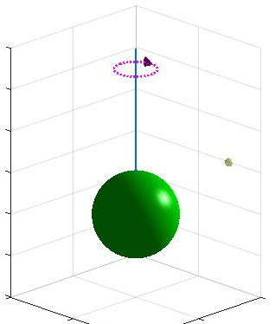
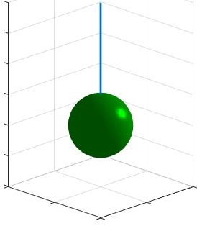
Motion Field and Optic Flow
1. We rotate the rod. No motion is observable.Light source (yellow) is fixed.
Sphere experiment
Sphere is attached to blue rod

Slide 4
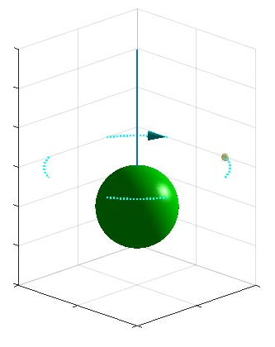
Sphere experiment
2. We rotate the light source. The sphere is still. Motion is observable because specular reflection moves.
Conclusions
When there is no pattern (only constant color) on the moving object
We may not observe motion when the object moves.
We may observe motion even if the object does not move at all.
The pattern on the moving object is crucial for observability of the motion.

Slide 5
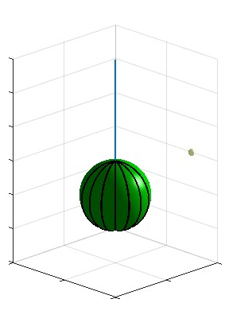

Sphere experiment
What pattern should we draw/paint on the sphere for maximal observability when rotating it with the rod?
What pattern should we draw/paint on the sphere for minimal observability when rotating it with the rod?

Slide 6
Aperture problem
When there is only one direction in the pattern of the moving patch…we always have the aperture problem. The problem is the risk of not observing the motion along the direction (of the pattern). All linearly symmetric patterns will cause aperture problem and vice versa.
If we have two distinct directions (preferably orthoghonal) we will not have aperture problem.

Slide 7
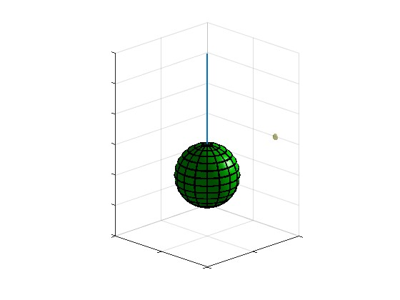
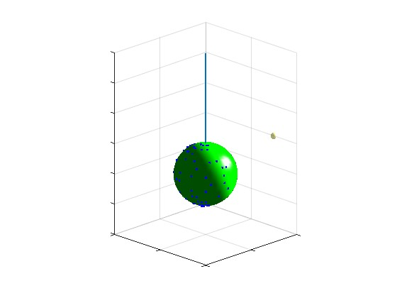
Sphere experiment
Conclusion: If we keep changing the rotation axis, neither meridians nor latitude lines may be sufficient
to observe the motion.
What pattern should we draw/paint on the sphere to always guarantee observability when rotating it along any axis?

Slide 8

Motion estimation in image sequences
Point motion (Spaghetti)
Line motion (Lasagne)
y
t
x
The problem can also be formulated as
problem of direction estimation of pink lines
or pink planes in 3D i.e. in x,y,t space.

Slide 9

https://www.opticalillusion
net/optical-illusions/the-barber-pole-illusion/

Slide 10
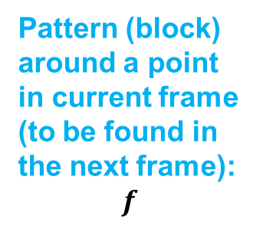

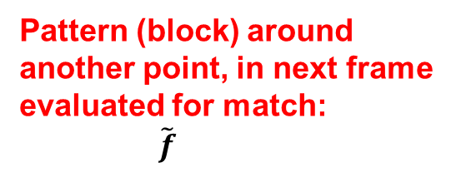
Optical flow by Displaced Frame Difference (DFD)
Synonyms: Optical flow by Block matching, Optical flow by Correlation
Search window
relative the original
Pixel location
Candidate Velocity
Vector

Slide 11
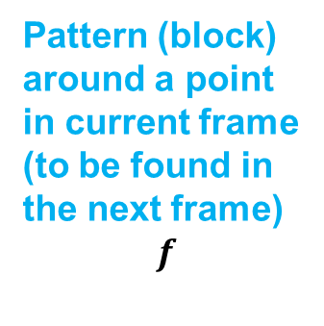
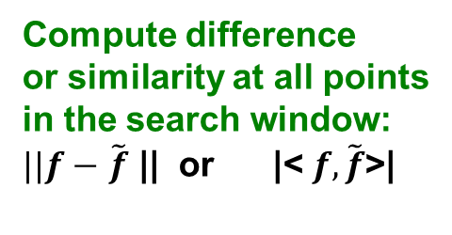
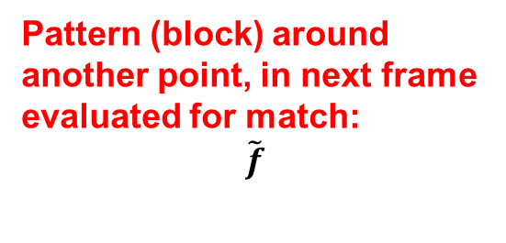
Optical flow by Displaced Frame Difference (DFD)
Search window
Relative the original
Pixel location

Slide 12
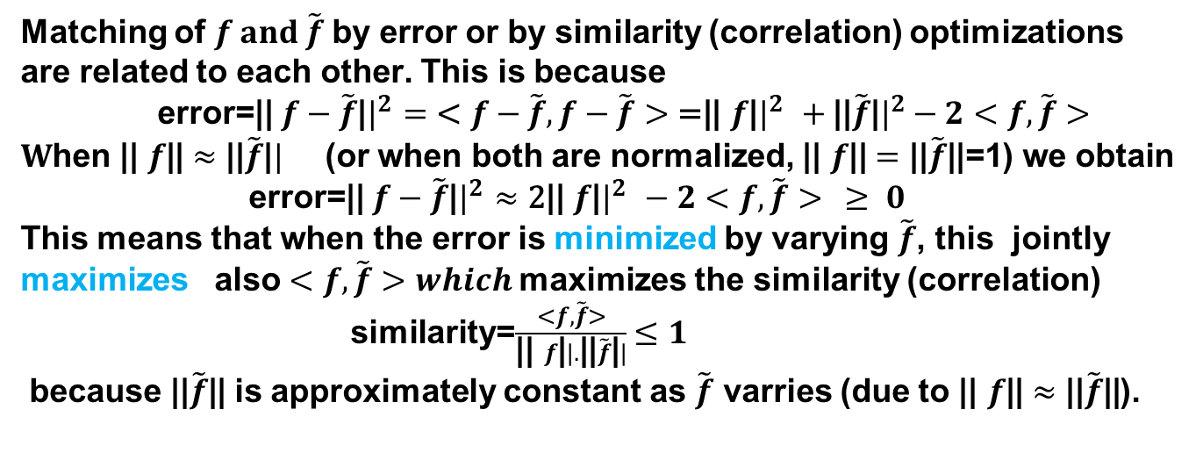
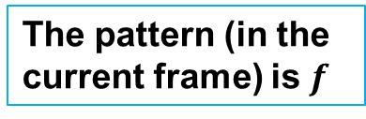
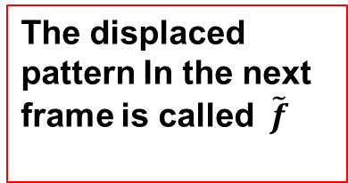
Optical flow by Displaced Frame Difference (DFD)
Search window
relative the original
pixel location
The pattern (in the current frame) is $f$
The displaced pattern In the next frame is called$\tilde{f}$

Slide 13
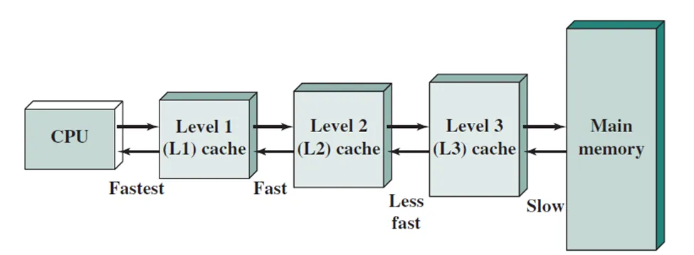
Access hierarchy of CPUs to Random Access Memory (RAM )
using hieararchy of cache types (L1,L2, and L3).
Image origin: https://medium.com/@ckekula/understanding-cache-memory-df5c4003d99f

Slide 14
Machine Type | L1 Cache Size | L1 Cache Cycles | L2 Cache Size | L2 Cache Cycles | L3 Cache Size | L3 Cache Cycles | Cores and Clock Speeds
Dell Latitude Laptop (Intel Core i7-11850H) | 64KB per core | 1-2 cycles | 512KB per core | 3-10 cycles | 24MB shared | 10-30 cycles | 8 cores (up to 4.8 GHz)
Mobile Phone (Qualcomm Snapdragon 8 Gen 2) | 64KB per core | 1-2 cycles | 512KB per core | 3-10 cycles | 8MB shared | 10-30 cycles | 8 cores (1x 3.2 GHz, 2x 2.8 GHz, 2x 2.8 GHz, 3x 2.0 GHz)
Conclusion: It may pay off well if pixel values (data) to be accessed
are stored close to each other in the memory.

